Slide 1

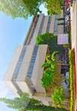

University of Southeastern Philippines
College of Engineering
An On-Road Kinetic Energy Harvester Using Electromagnetic: Gear and Generator Type Technologies
Solomon F. Castillo

Slide 2
Outline of the Presentation
Background of the Study
Problem and Objectives
Significance of the Study
Scope and Limitation of the Study
Materials and Methods
Barriers to Success
Timeline
References
University of Southeastern Philippines
COLLEGE OF ENGINEERING

Slide 3
Background of the Study
Non-renewable energy sources are limited while energy consumption is increasing every year.
Advancements in renewable energy technologies have been beneficial in providing energy, however, this is still not enough.
It is necessary to find new ways of producing energy using renewable energy sources before non-renewable energy sources run out.
In the Philippines alone, the amount of energy produced yearly is steadily decreasing. One of the factors is the decreasing contribution of renewable energy to the production of electric energy to the country. (“Energy consumption in the Philippines,” 2016)
University of Southeastern Philippines
COLLEGE OF ENGINEERING

Slide 4
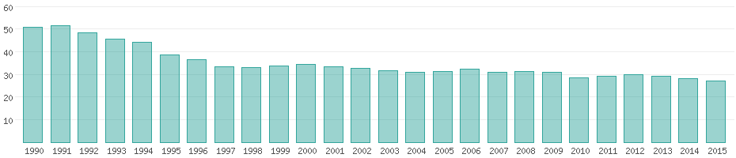
Background of the Study
The percentage share of renewable energy sources from 1990 to 2015. Taken from https://www.worlddata.info/asia/philippines/energy-consumption.php.
University of Southeastern Philippines
COLLEGE OF ENGINEERING

Slide 5
Problem and Objectives
Problem of the Study
Energy crisis in the Philippines
Objectives of the Study
To design a functional energy harvester
To analyze the energy harvested
To provide recommendations regarding future research
University of Southeastern Philippines
COLLEGE OF ENGINEERING

Slide 6
Significance of the Study
The proposed study would prove to be useful to the following entities:
Proponent
Energy sector
Government
Future research
The proposed study is in line with the Research Agenda of the University. Specifically, Power Generation and Renewable Energy of Cluster A: Technology Generation and Energy Efficiency.
University of Southeastern Philippines
COLLEGE OF ENGINEERING

Slide 7
Scope and Limitation of the Study
The storage or load for the harvested energy is outside the scope of the study.
The properties of the harvested energy will be analyzed.
The use, optimization, and modification of a model electric generator is within the scope of the study.
Road conditions other than flat concrete or cement road in dry and wet conditions are outside the scope of the study.
Vehicle variations other than 2-wheeled motorcycles, hatchbacks, pick-ups, and SUVs are outside the scope of the study.
University of Southeastern Philippines
COLLEGE OF ENGINEERING

Slide 8
Materials and Methods
To validate the concept of this proposed study, computer-aided modeling and simulation will be conducted. The following are the materials and tools required to conduct the proposed study:
Computer
AutoCAD (Modeling software)
ANSYS Academic (Simulation software)
University of Southeastern Philippines
COLLEGE OF ENGINEERING

Slide 9
Materials and Methods
The procedure is as follows:
Initial calculations
Modeling 1
Modeling 2
Simulation
Tabulation of simulation results
Optimization of the design
Finalization of the product
The simulated ORKEH will contain:
A pressure plate
Mechanical motion rectifier (MMR)
Springs
Electromagnetic generator
Gear racks
Gears
Electrical load
University of Southeastern Philippines
COLLEGE OF ENGINEERING

Slide 10
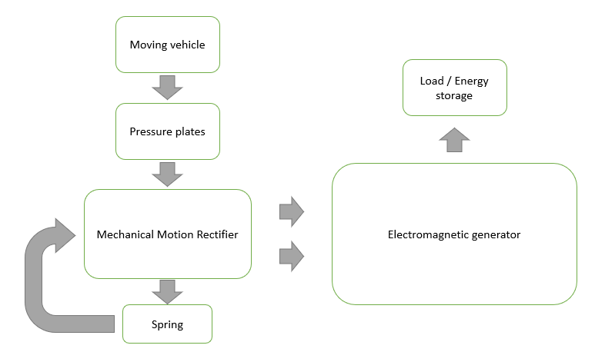
Materials and Methods
Initial block diagram of the flow of energy of the on-road kinetic energy harvester
University of Southeastern Philippines
COLLEGE OF ENGINEERING

Slide 11
Barriers to Success
The following are the potential barriers to the success of the proposed study:
Miscalculations in the product models.
Simulated conditions might not accurately reflect real world conditions.
Incorrect input values for the simulation of the product.
University of Southeastern Philippines
COLLEGE OF ENGINEERING

Slide 12
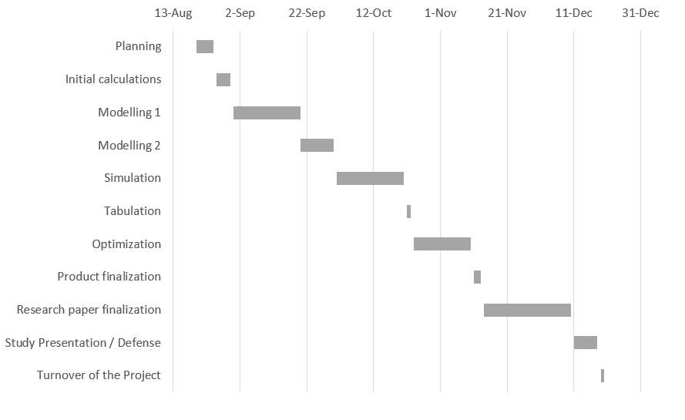
Timeline
University of Southeastern Philippines
COLLEGE OF ENGINEERING

Slide 13
References
Energy consumption in the Philippines. (2016). Retrieved April 24, 2019, from Worlddata: The world in numbers website: https://www.worlddata.info/asia/philippines/energy-consumption.php
University of Southeastern Philippines
COLLEGE OF ENGINEERING

